Slide 1
TRUSTWORTHY MANET ROUTING ESTAODV IMPLEMENTATION USING DEEP REINFORCEMENT LEARNING
NBQSA Presentation

Slide 2

Group Members: IT14085918 - M.A.J. Niroshan
IT15564078 - K.A.H. Kodithuwakku
IT14098888 - Liyanage S.C.G.
IT15143914 - M.A.S.H. Kularatna
Supervisor: Mr. Prabath Lakmal Rupasinghe

Slide 3
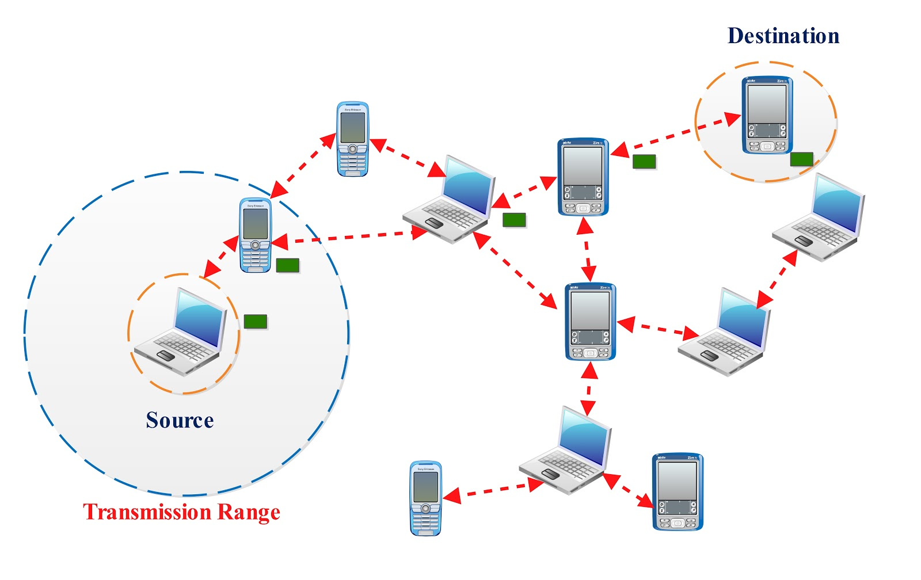
MANET
Mobile Ad Hoc Network
Self organized
Wireless
Mobile nodes
No infrastructure
Limited coverage area

Slide 4
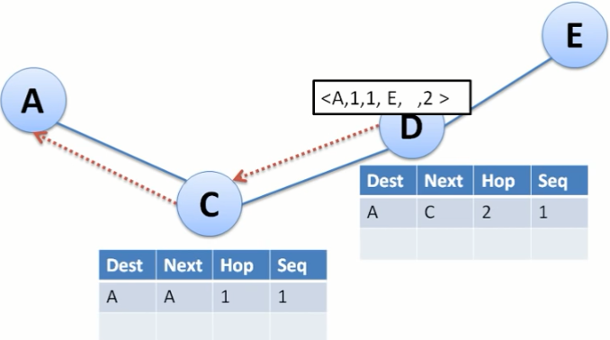
AODV
Ad Hoc On-Demand Distance Vector
Reactive routing
RREQ & RREP
Shortest path for packet transferring

Slide 5
Business Value

Slide 6
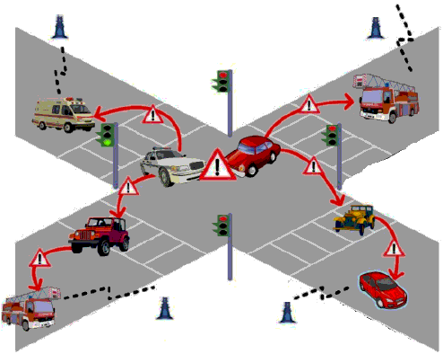
VANET
Vehicle collision warning
Traffic information
Effective bandwidth utilization

Slide 7
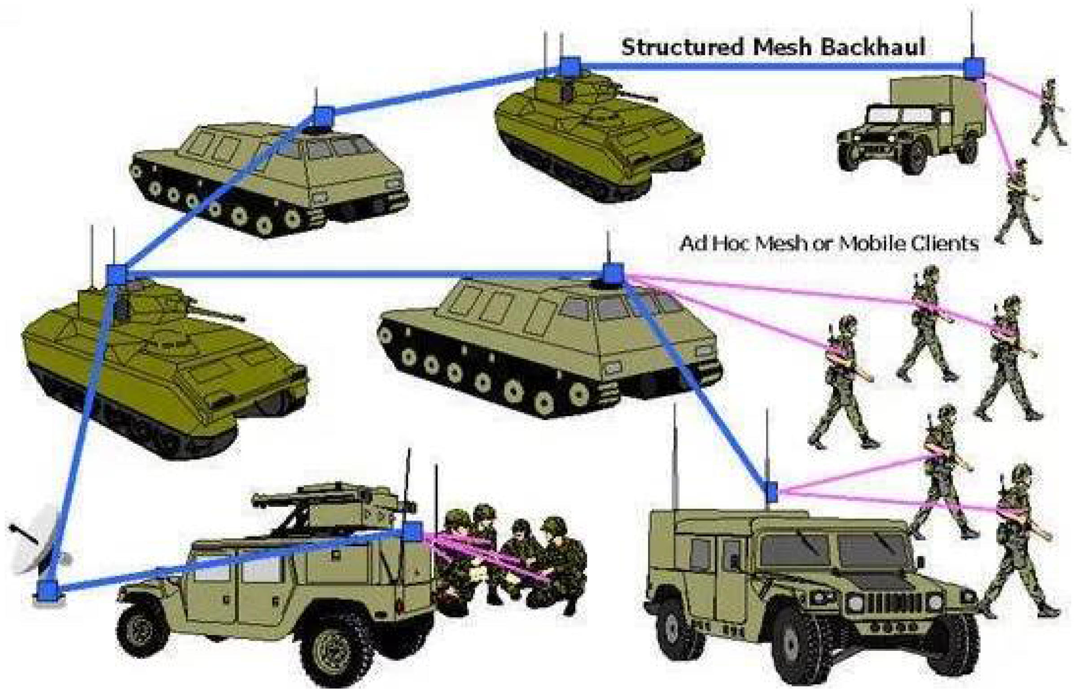
Military Operations
Unmanned army system
Surveillance
Future combat operations

Slide 8
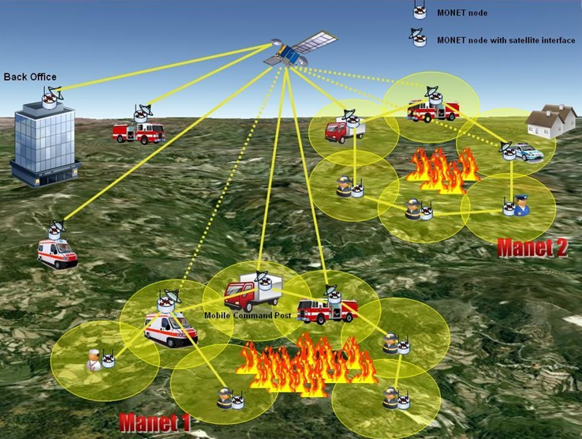
Disaster Relief Operations
Track human mobility to fix disaster management services
In cases of telecommunication damages

Slide 9
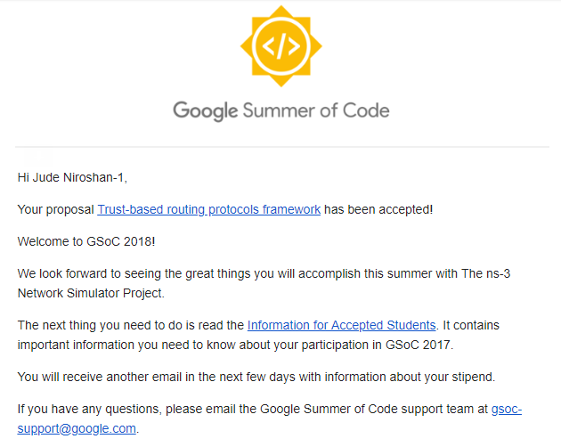

Slide 10
Trust is a connection between the trustor and the trustee that can be symmetric or awry.

Slide 11
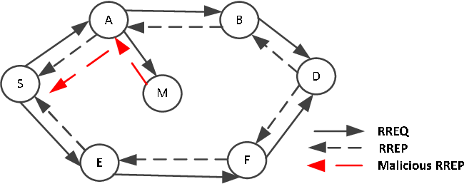
Malicious Node Behavior

Slide 12
Solution

Slide 13
Malicious node discovery
Distinguish trustworthy and malicious nodes.
Past experiences
Calculate trust based on the previous individual experiences.
Neighbor Recommendations
Consider recommendations of neighbor nodes.

Slide 14
Trust levels
Trustworthy
Partially Trustworthy
Selfish
Pure Malicious
Collaborative Malicious

Slide 15
Features

Slide 16
Analyze performance metrics when detecting the secured and reliable routes using proposed trust-based schema.
Evaluate Trustworthiness
Spiral Model
Trust Recommendation Request (TRR) protocol
Q-Learning mechanism (Most Secured route Prediction)

Slide 17
Analyze performance metrics when detecting the secured and reliable routes using proposed trust-based schema.
Performance Analysis
Trust Framework

Slide 18
Proof of Concepts
Protocol based scheme [R. Dalal, Manju Khari]
Communication among network nodes happened through agents called ants.
Intrusion Detection Model (IDM), Intrusion Response Model (IRM) [T. Farid, A. Prahladachar]
Uses neighbor node information to identify and isolate malicious nodes.

Slide 19
Proof of Concepts Continued..
ST-AODV [Sridhar Subramanian and Baskaran Ramachandran]
Calculate request rate, reply rate and data transmission rate of network nodes.
EBoX [Santhosh J and Malini V K]
Uses a reputation-based schema to award penalty points and credit points.

Slide 20
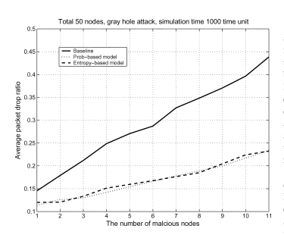
Traditional vs. Model Based

Slide 21
Uniqueness

Slide 22
Direct trust and indirect trust
Trust Level Classification
Consider neighbor recommendations
Update Trust Dynamically

Slide 23
Uniqueness Continued..
Most trustworthy route instead of the shortest path.
Identify and remove malicious nodes dynamically.

Slide 24
Scope

Slide 25
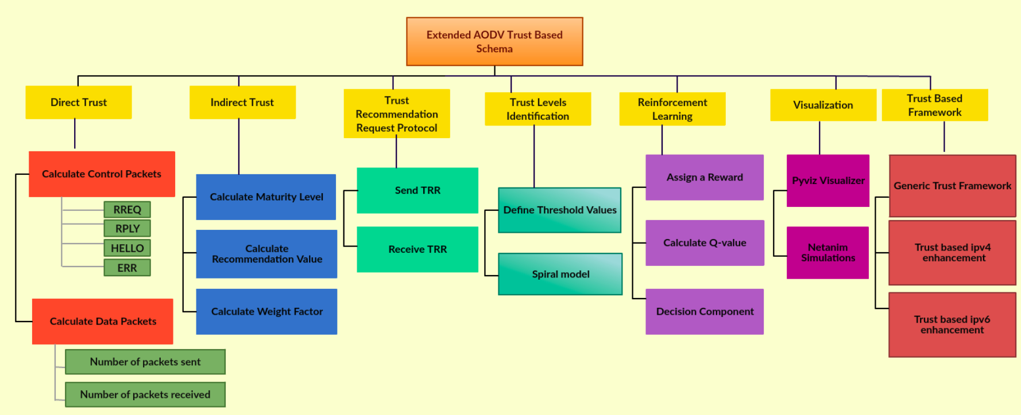

Slide 26
System Diagram

Slide 27
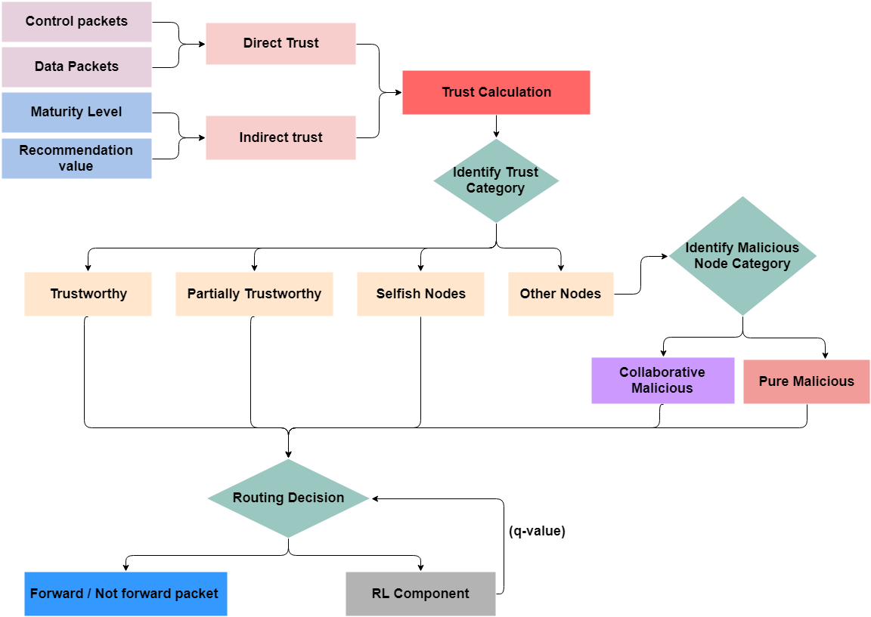

Slide 28
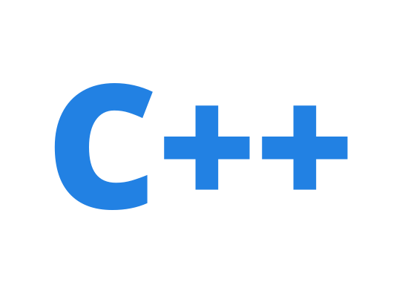



Technologies

Slide 29



Frameworks/ Libraries

Slide 30

Q & A

Slide 31
THANK YOU!

